Slide 1





The Bedrock of Byzantine Fault Tolerance
A Unified Platform for BFT Protocols Analysis, Implementation, and Experimentation
Mohammad Javad Amiri¹, Chenyuan Wu², Divyakant Agrawal³, Amr El Abbadi³, Boon Thau Loo², Mohammad Sadoghi⁴
¹Stony Brook University, ²UPenn, ³UC Santa Barbara, ⁴UC Davis

Slide 2



Distributed transaction processing
Tnx_3
Tnx_2
Tnx_1
ID | Name | BAL
1 | Alice | 20
2 | Bob | 10
3 | Carol | 15
ID | Name | BAL
1 | Alice | 2010
2 | Bob | 1020
3 | Carol | 15
Tnx_3
1: (Alice,Bob,10)
Tnx_2
Tnx_1
Accepted!
(Alice,Bob,10)
Tnx_3
Accept?
1: (Alice,Bob,10)
Tnx_2
Commit
ID | Name | BAL
1 | Alice | 20
2 | Bob | 10
3 | Carol | 15
Tnx_1
ID | Name | BAL
1 | Alice | 2010
2 | Bob | 1020
3 | Carol | 15
ID | Name | BAL
1 | Alice | 2010
2 | Bob | 1020
3 | Carol | 15
ID | Name | BAL
1 | Alice | 20
2 | Bob | 10
3 | Carol | 15
Accepted!
State Machine Replication: a replicated service whose state is mirrored across different deterministic replicas
Assign order to each client request in the global service history and execute it in that order

Slide 3

Byzantine fault-tolerant protocol: PBFT
Nodes can fail arbitrarily, including deviating from the protocol
Pre-prepare
Prepare
Commit
At Most f
Byzantine Failures
PBFT
2f+1
2f+1
3f+1

Slide 4
BFT protocols landscape
F₁₀
Zyzzyva5
Zyzzyva
Tendermint
PoE
SBFT
Kauri
F₈
F₄
F₇
F₆
F₁₄
F₁₀
F₉
F₁
F₃
Q/U
Quorum
PBFT
Linear PBFT
HotStuff
F₅
F₁₂
F₂
F₁₃
F₁₀
CheapBFT
Prime
Bosco
FaB
Themis
What protocol best fits our needs?
Analysis
Implementation
Experimentation

Slide 5
BFT protocols design space and design dimensions
Design space
A set of dimensions to analyze BFT protocols
Design choices
Trade-offs between dimensions
A set of one-to-one functions, each maps protocols in its domain to protocols in its range
Focus on partially synchronous BFT protocols
# replicas
range
domain
7f+1
5f+1
3f+1
1
2
3
# commitment
phases

Slide 6
Different stages of replicas in a BFT protocol
Requests
r₁
Ordering
Execution
View-Change
Check
pointing
Recovery
r₂
Recovery
client
r₃
Recovery
client
...
r_{n}
Recovery

Slide 7

PBFT
c
Request
Pre-prepare
Prepare
Commit
Exe.
Reply
View-change
New view
Checkpointing
Recovery
r₁
r₂
r₃
r₄
Contact Replica
O(n)
O(n²)
O(n²)
All nodes
O(n²)
O(n)
O(n²)
proactive

Slide 8
Design space of BFT protocols
Protocol structure
P1. Commitment strategy
P2. Number of commitment phases
P3. View-change
P4. Checkpointing
P5. Recovery
P6. Types of clients
Quality of Service
Q1. Order-fairness
Q2. Load balancing
Performance Optimization
O1. Out-of-order processing
O2. Request pipelining
O3. Parallel ordering
O4. Parallel execution
O5. Read-only requests processing
O6. Separating ordering and execution
O7. Trusted hardware
O8. Request/reply dissemination
Environmental Settings
E1. Number of replicas
E2. Communication topology
E3. Authentication
E4. Responsiveness, synchronization, and timers

Slide 9
Design choices
1. Linearization
2. Phase reduction through redundancy
3. Leader rotation
4. Non-responsive leader rotation
5. Optimistic replica reduction
6. Optimistic phase reduction
7. Speculative phase reduction
8. Speculative execution
9. Optimistic conflict-free
10. Resilience
11. Authentication
12. Robust
13. Fair
14. Tree-based LoadBalancer

Slide 10
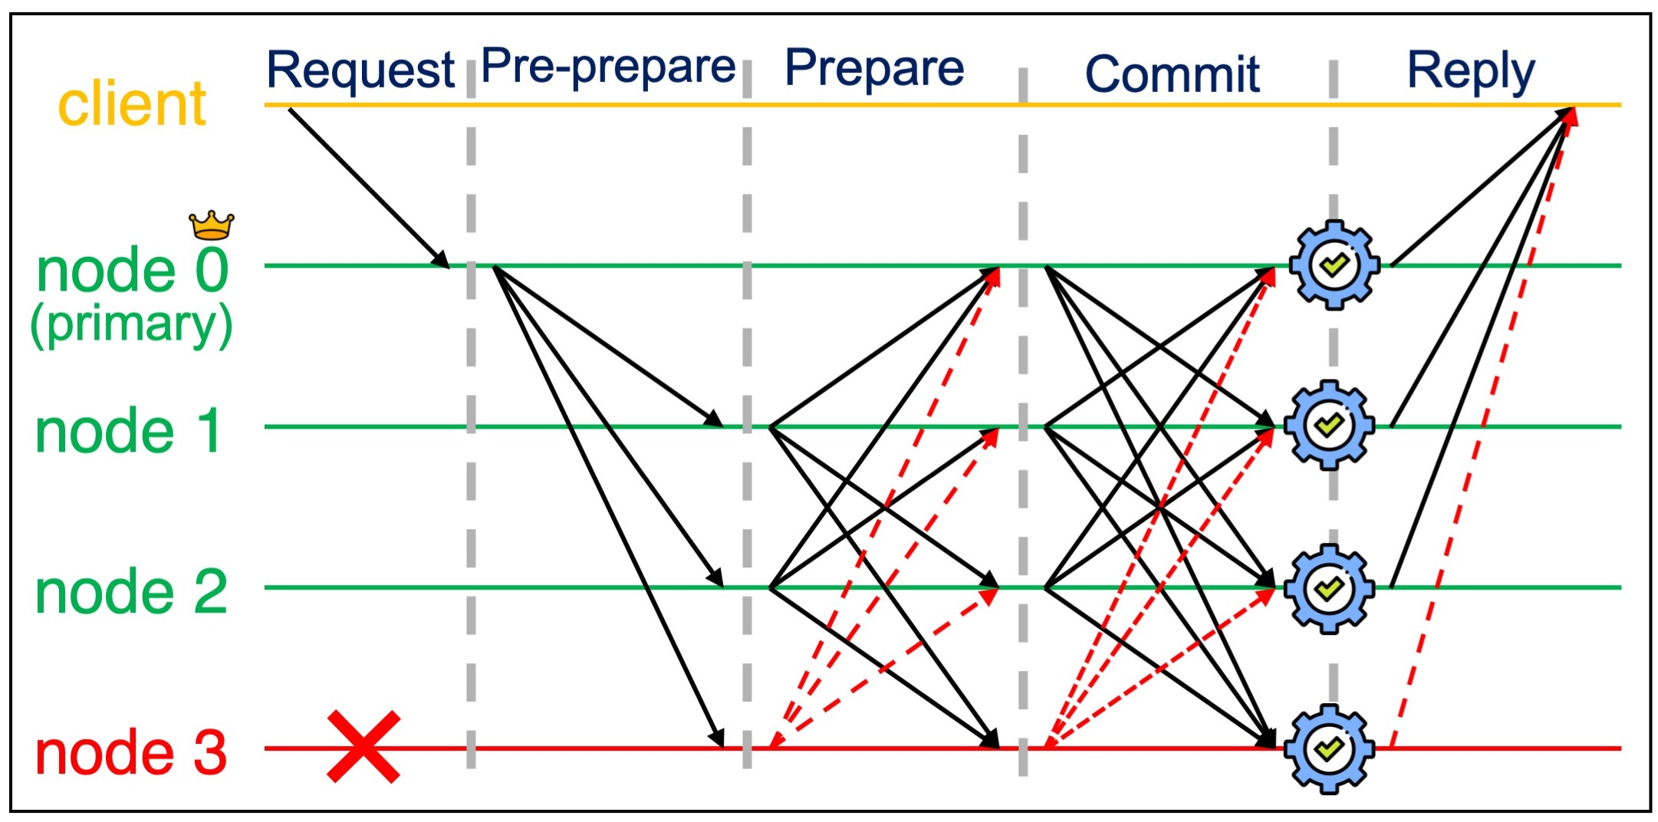
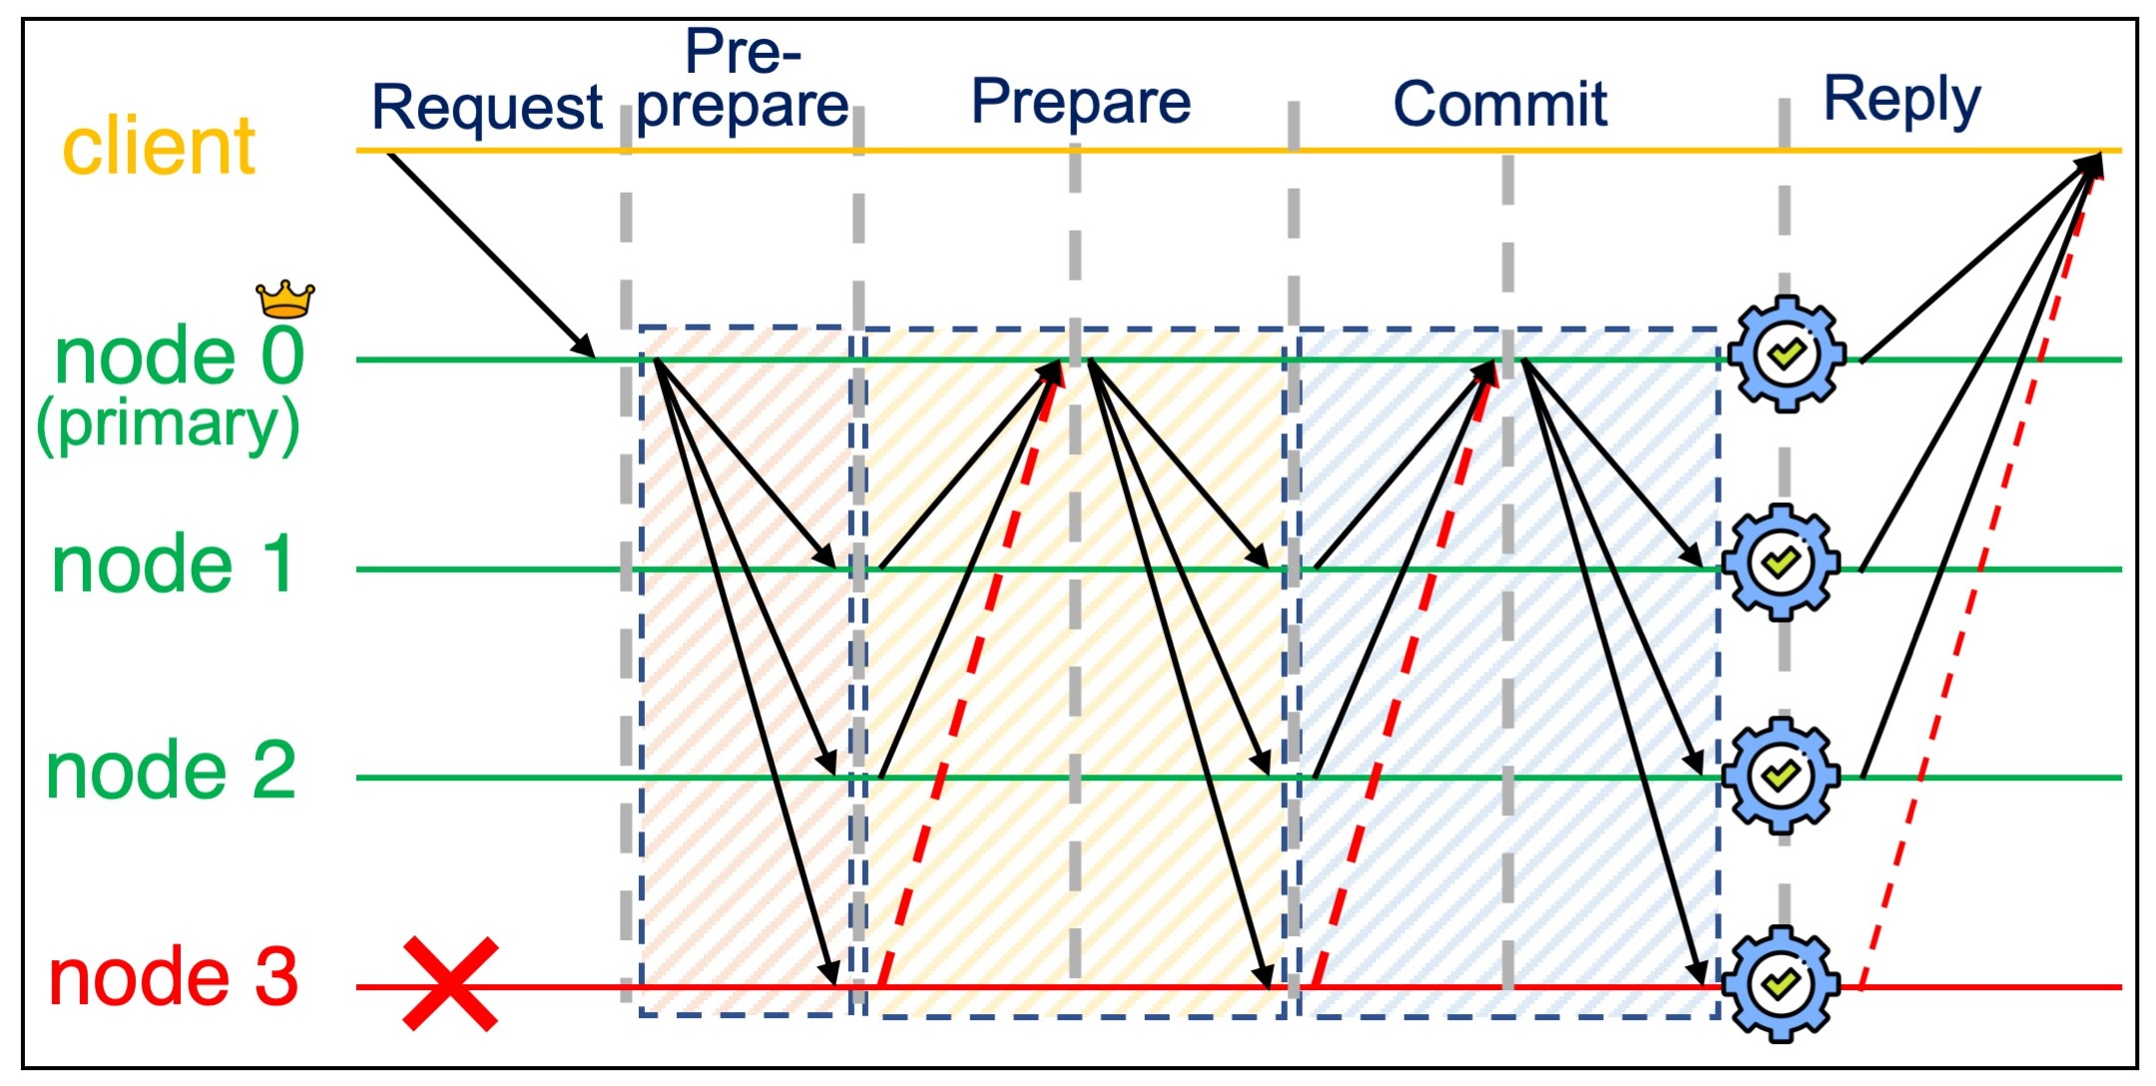

Design choice 1: Linearization
Trade-off between communication topology and communication phases.
Linear PBFT
The collector needs to send a certificate of having received the required signatures.

Slide 11
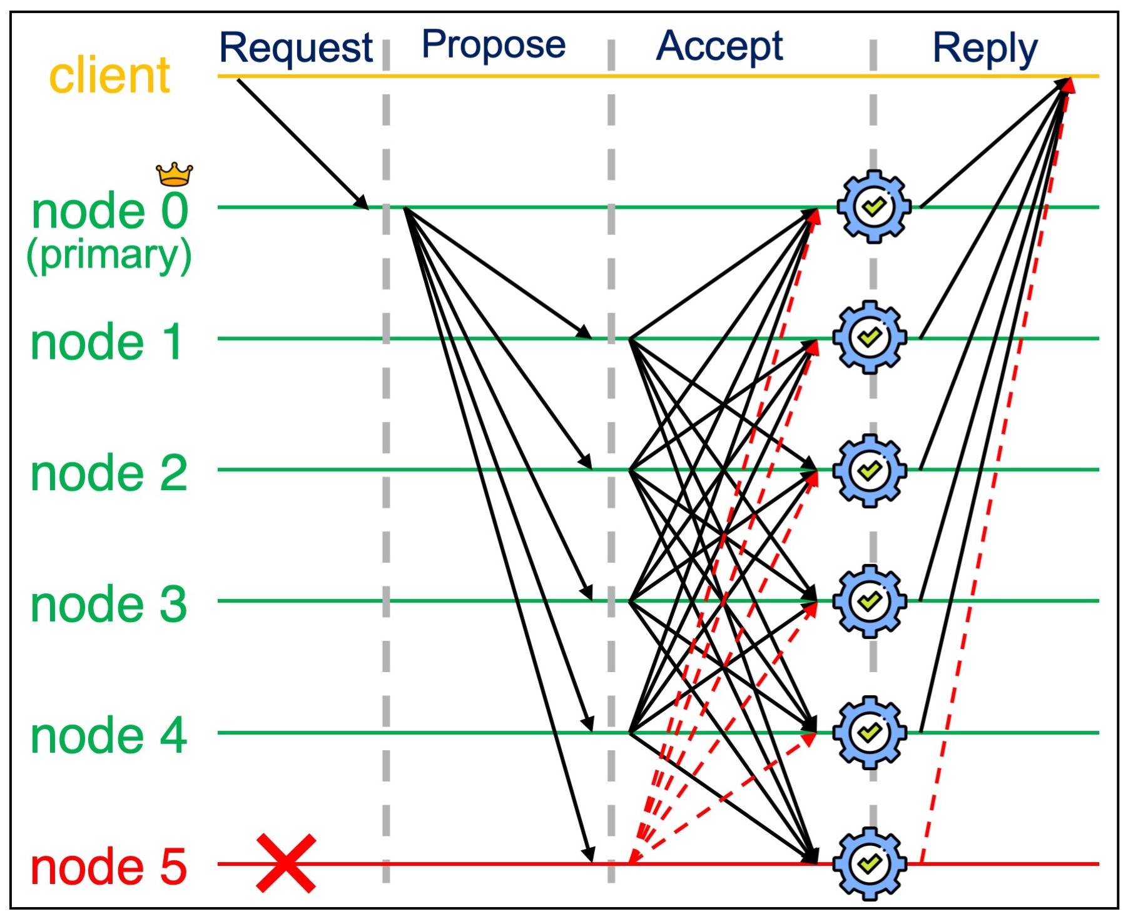
Design choice 2: Phase reduction through redundancy
Trade-off between the number of ordering phases and the number of replicas
FaB

Slide 12
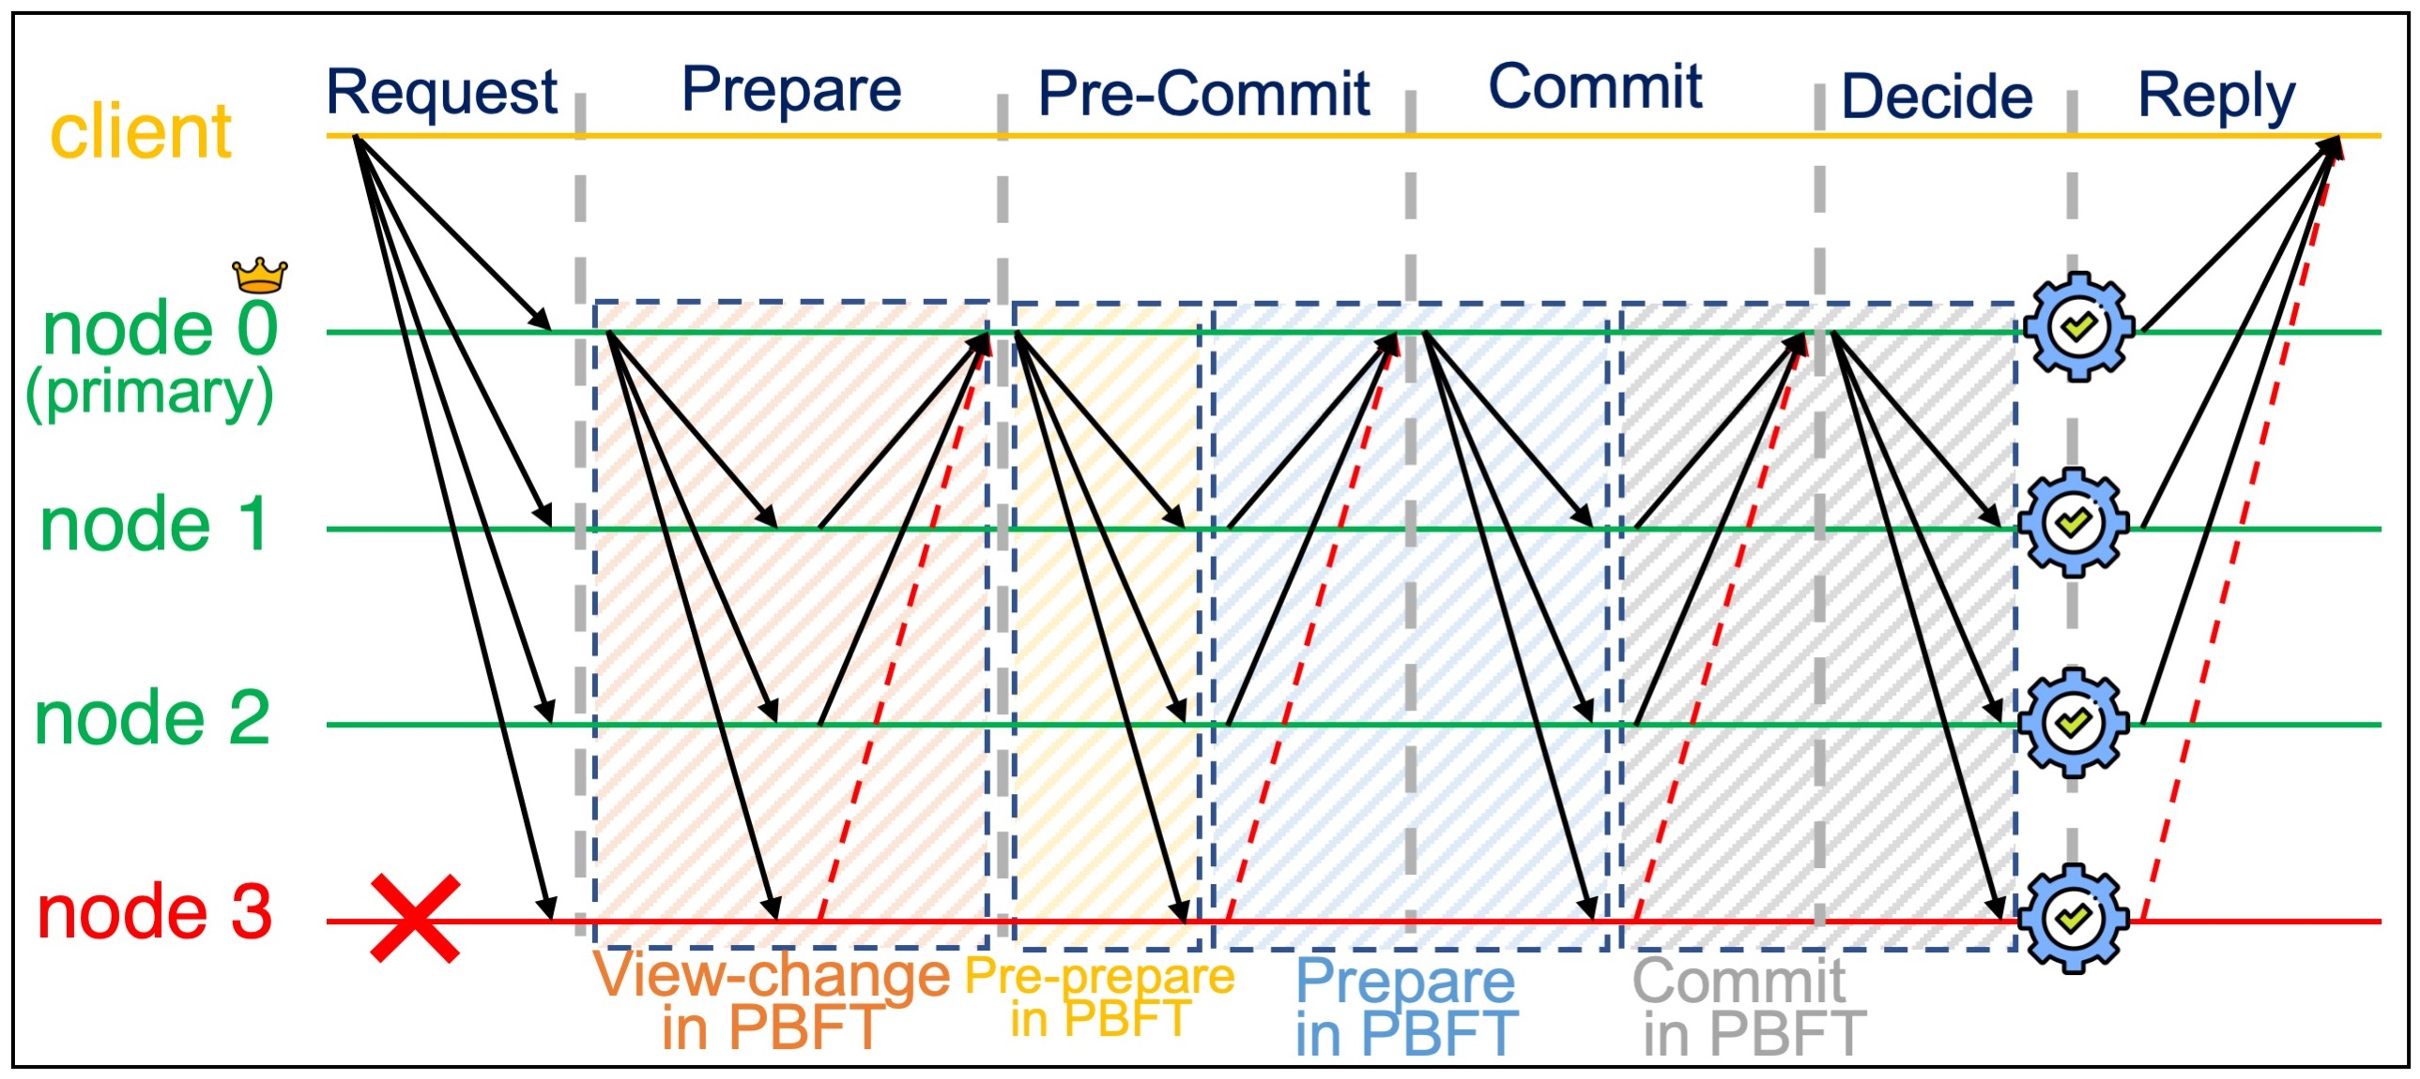
Design choice 3: Leader rotation
Replace the stable leader with the rotating leader mechanism by adding one phase
HotStuff

Slide 13
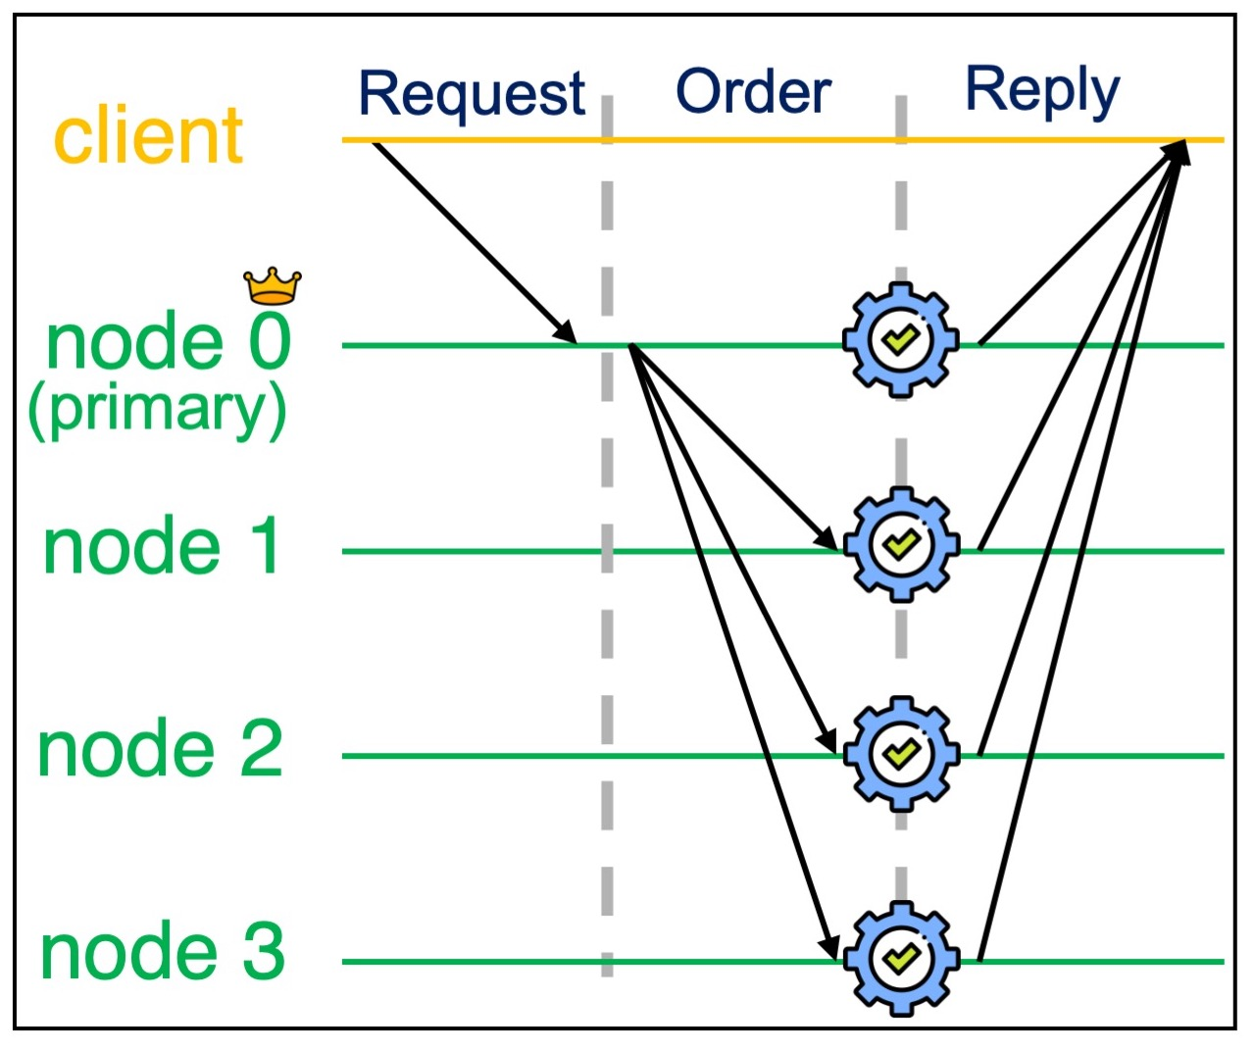
Design choice 8: Speculative execution
Eliminate the prepare and commit phases while optimistically assuming that all replicas are non-faulty
Zyzzyva

Slide 14
Derivation of protocols from PBFT using design choices
1. Linearization
2. Phase reduction through redundancy
3. Leader rotation
4. Non-responsive leader rotation
5. Optimistic replica reduction
6. Optimistic phase reduction
7. Speculative phase reduction
8. Speculative execution
9. Optimistic conflict-free
10. Resilience
11. Authentication
12. Robust
13. Fair
14. Tree-based LoadBalancer
F₁₀
Zyzzyva5
Zyzzyva
Tendermint
PoE
SBFT
Kauri
F₈
F₄
F₇
F₆
F₁₄
F₁₀
F₉
F₁
F₃
Q/U
Quorum
PBFT
Linear PBFT
HotStuff
F₅
F₁₂
F₂
F₁₃
F₁₀
CheapBFT
Prime
Bosco
FaB
Themis

Slide 15
Implementation
The core unit
Defines entities, e.g., clients and nodes, and maintains the application logic and data
Defines workloads and benchmarks
The state manager
Enables the core unit to track the states and transitions of each entity according to the protocol
Defines a domain-specific language (DSL) to rapidly prototype BFT protocols
The plugin manager
Implements protocol-specific behaviors that cannot be handled by the protocol config
Enables users to define their own dimensions/values or to update existing dimensions without requiring changes to the platform code or rebuilding the platform binaries
The run-time unit
Manages the run-time execution
E.g., manages benchmarks, setups all entities, enables plugins to run, reports results

Slide 16
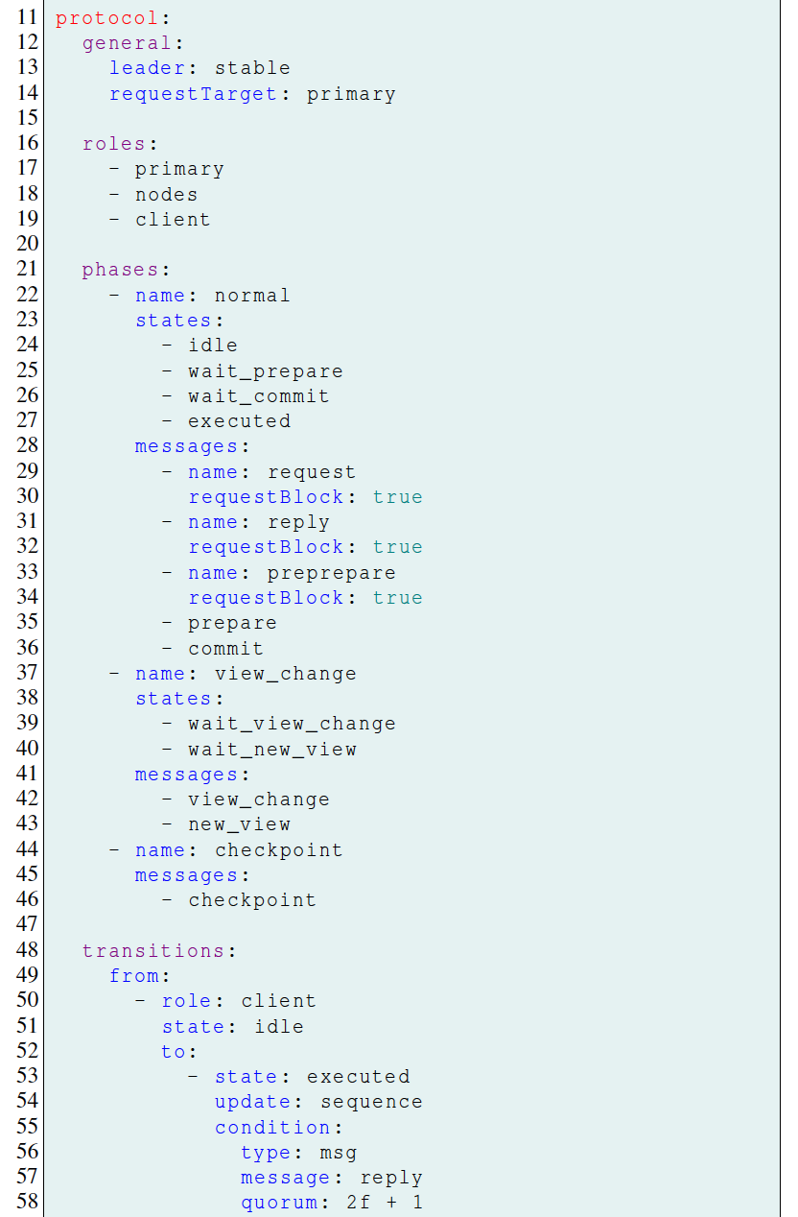
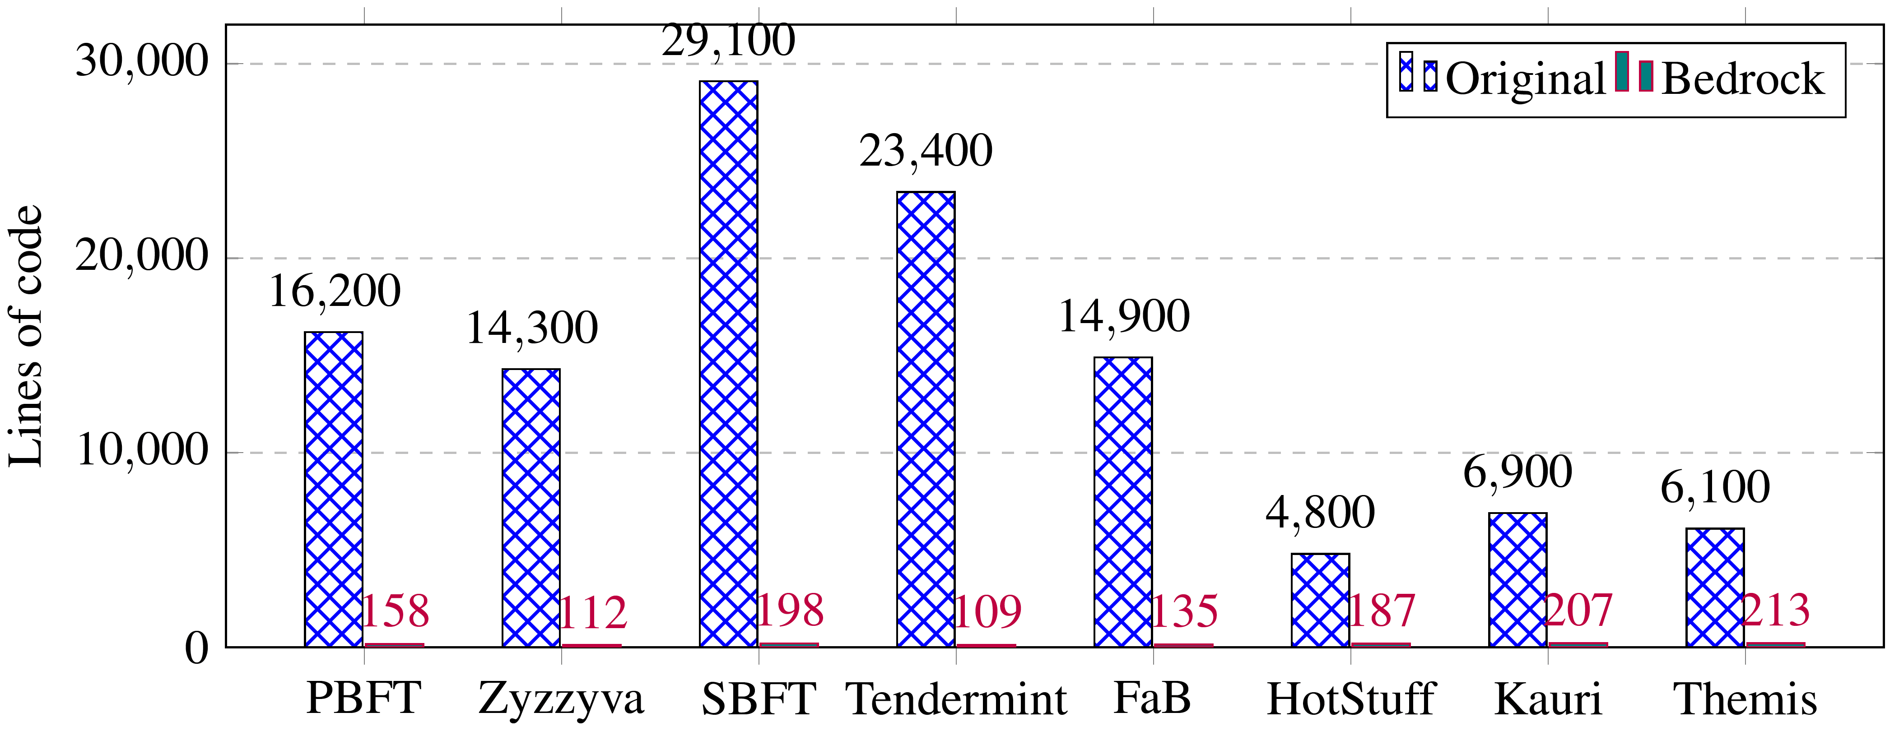
DSL code
Written in the protocol config
Defines different dimensions and their chosen values, the list of roles, phases, states, messages, quorum conditions, and plugins
Reduces the effort needed to write a BFT protocol

Slide 17

Experimental settings
Platform: Amazon EC2
PBFT, Zyzzyva, SBFT, FaB, PoE, (Chained-)HotStuff, Kauri, Themis, FLB and FTB.
Evaluate the impact of the impact of design choices 1, 2, 3, 6, 7, 8, 10, 11, 13, and 14
Workload with client request/reply payload sizes of 128/128 byte.
Measuring performance
Throughput
Latency

Slide 18
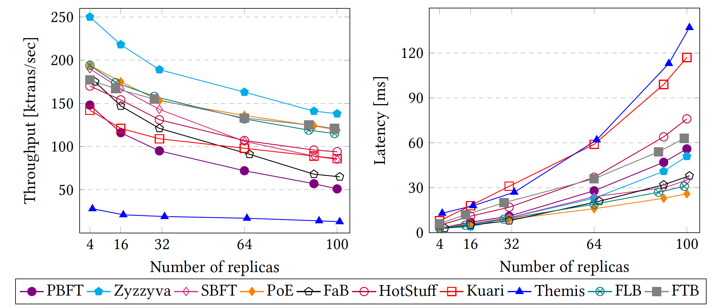
Performance with different number of replicas

Slide 19
Future work
Enabling users to check the correctness of their written protocols
Transforming the DSL code written in Bedrock to the language used by verification tools
Diversifying replica implementation using n-version programming
To ensure the independent failure of replicas
Extending the supported protocols
E.g., adding synchronous and fully asynchronous protocols
Enabling scalable transaction processing
Running different instances of consensus protocols in parallel
Incorporating automatic selection strategies in Bedrock
Using machine learning to select the appropriate BFT protocol, or switch protocols at runtime

Slide 20

Questions?

